Slide 1
Bazley – Discrimination and Economic expectations
Study Focus: Examines the affect of perceived discrimination on economic expectations
for individuals in the U.S.
Context: Uses experimental data with participants exposed to narratives of either pervasive or rare discrimination.
Findings: Households exposed to pervasive discrimination reported 8% higher income uncertainty and 5% higher inflation uncertainty. For racial/ethnic minorities, income uncertainty increased by 12-16%, and inflation uncertainty by 10-12% under pervasive discrimination conditions. However, no evidence suggests that these effects were driven by demographic or socioeconomic factors alone; psychological and emotional factors also play a role.
Secondary Findings: Follow-up experiment indicates that discrimination impacts expectations through stress, negative emotions, and rumination.
Conclusion: Perceptions of discrimination act as a significant social influence on economic beliefs, especially for minority groups, emphasizing the importance of non-economic factors in shaping financial expectations.

Slide 2
Bazley – Discrimination and Economic expectations
Slides | Table | Sections
1 – 7 | Table 1: Summary Statistics | Replication of Panels A and B
8 – 12 | Table 3: Effects of Discrimination on Income Uncertainty | Replication of Models (1) and (2)
13 – 20 | Table 3 Model (2): Improving the Model | Adding transformed and interaction variables

Slide 3
Table 1: Summary Statistics
The first table in the paper is of summary statistics for the demographic and socioeconomic variables of interest that will be used in the proceeding regressions.
They are split into two panels one for the Pervasive discrimination condition (A), and the rest for Rare discrimination (B).
They also report the p-values from two-sample t-tests comparing each variables’ mean for Panel A and B.

Slide 4
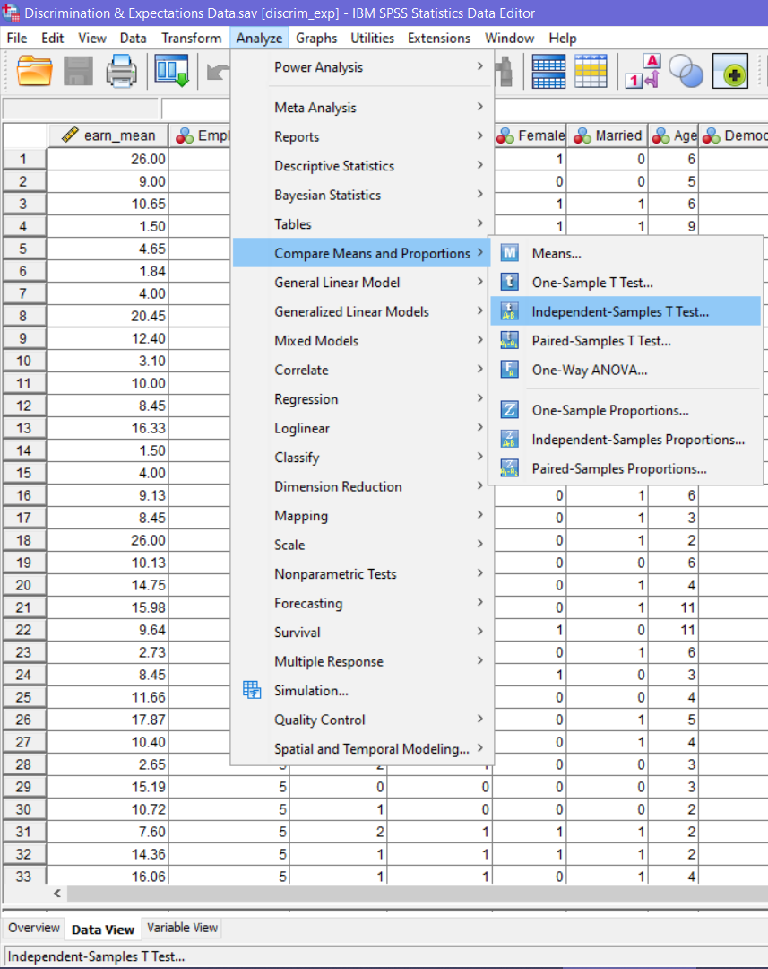
Table 1: Independent samples t-test procedure
1. Load the dataset “Discrimination & Expectations Data” in SPSS
2. Open the “Independent Samples T-Test” procedure
This method will produce the summary statistics for Panel A and B as well as conduct each t-test and report the p-values.

Slide 5
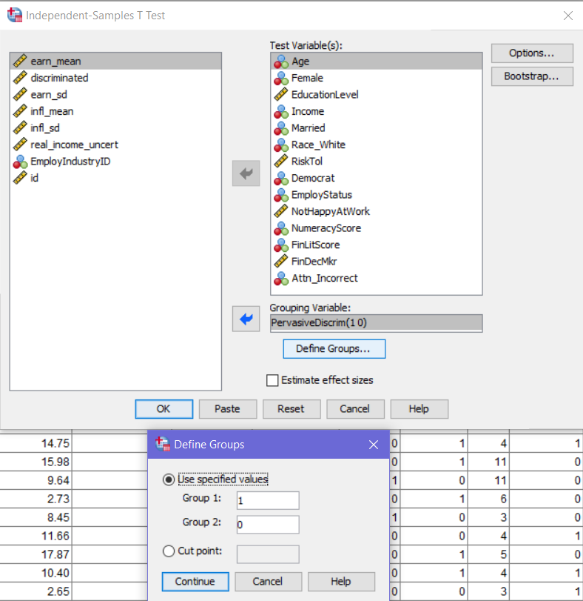
Table 1: Independent samples t-test procedure
3. Add all of the variables of interest to the “Test Variables” window
4. Add the PervasiveDescrim variable to the “Grouping Variable” window and deselect the “Estimate effect sizes” box
5. Click “Define Groups” and set Group 1 as 1 and Group 2 as 0 then click “Continue” and “OK” to produce the output
Group 1 represents Panel A and Group 2 represents Panel B

Slide 6
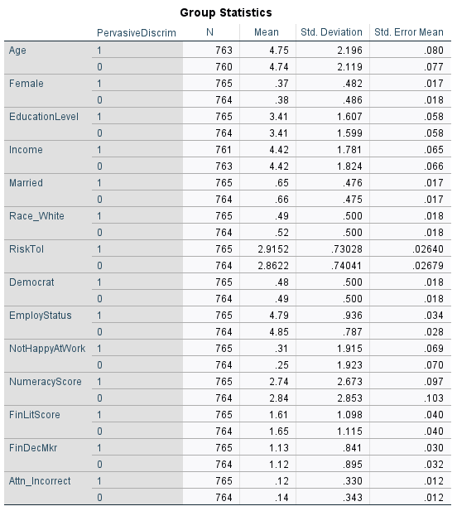
Table 1: Results
Compare the mean, standard deviation and N for each variable to the left output and Table 1 in the paper
Questions
1. What do you notice about the number of observations between the two condition groups (Panel A and B)? How might this be important for the analysis?
2. Based on the means between groups, do you expect there to be a significant difference for any of the variables?

Slide 7
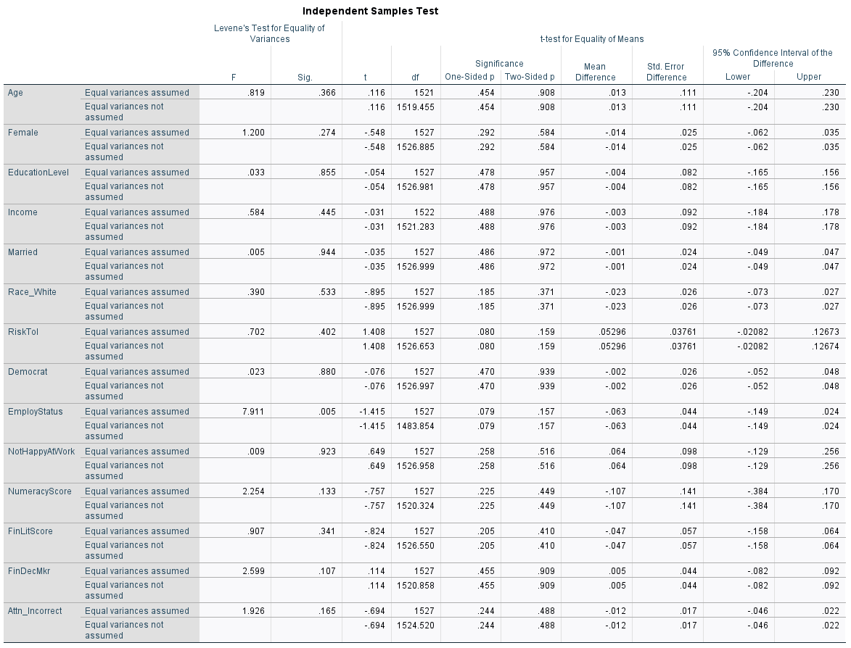
Table 1: P-values
Compare the Two-Sided p from the output to the p-value reported in the paper
Questions
3. Do any of the means of the variables between the pervasive and rare discrimination groups differ based on the p-values at the 5% level?

Slide 8
Table 1: Answers
1. When the sample sizes are similar, it reduces the risk of statistical bias and allows for comparisons between condition groups.
2. Overall, the means of the factors appear to be close. However, to confirm whether these differences are statistically significant we can conduct independent t-tests.
3. None of the variable means between the pervasive and rare discrimination groups differ significantly.

Slide 9
Table 3: Effects of Discrimination on Income Uncertainty
The third table in the paper shows the regression results for 6 different models that differ by restrictions of different control variables.
We will only be directly replicating the results from Models (1) and (2). The rest of the models utilize a Fixed Effects framework.
The dependent variable for each regression is Income Uncertainty, which is the standard deviation of the participant’s expected earnings growth rate and is labeled earn_sd in the dataset.
The independent variable of interest for each regression is Pervasive Discrimination (PervasiveDiscrim)

Slide 10
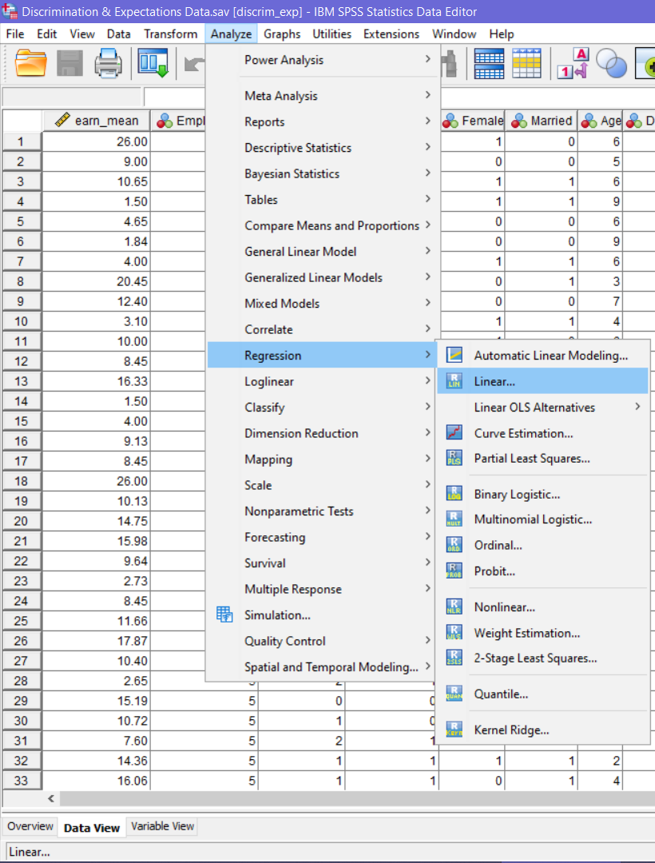
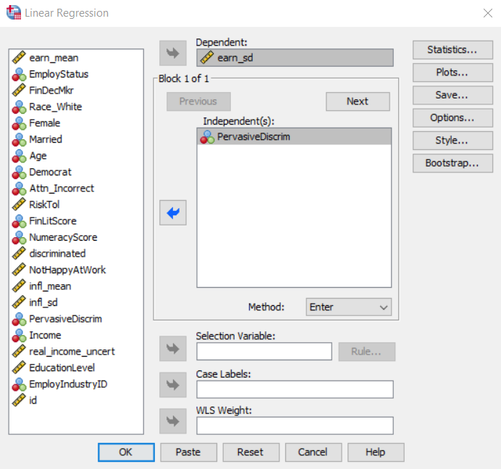
Table 3 Model (1): Linear Regression Procedure
1. Open the “Linear” regression procedure
2. Add earn_sd as the dependent variable and PervasiveDiscrim as the independent
3. Click “OK” to run the model

Slide 11
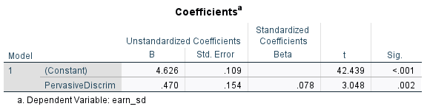
Table 3 Model (1): Results
Compare the coefficient and t-statistic for the PervasiveDiscrim variable to Model (1) for Table 3 in the paper
Questions
4. Is the coefficient for Pervasive discrimination statistically significant at the 5% level?
5. What is the interpretation of the coefficient? Keep in mind that the dependent variable is the standard deviation of the participant’s expected earnings growth rate.

Slide 12
Table 3 Model (1): Answers
4. Yes, the p-value (.002) is less than the significance level (0.05)
5. If the participant was assigned to the pervasive discrimination group, the standard deviation of the participant’s expected earnings growth rate increased by 0.47%-point.
The author presents this in an alternative fashion by taking the coefficient over the mean of Income Uncertainty for the rare condition group (4.626). They estimate a 10% greater variability in expected income growth for participants who perceived higher levels of discrimination than those of the rare discrimination group. (0.470/4.626 = 0.1016)

Slide 13
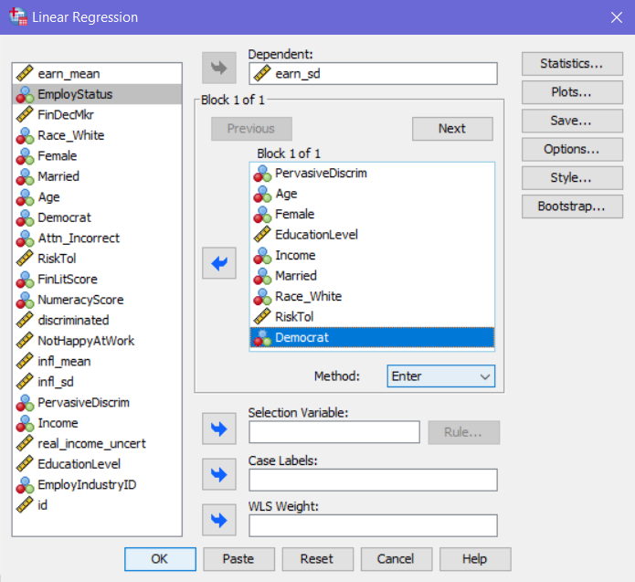
Table 3 Model (2): Linear Regression Procedure
6. Again, using the Linear regression procedure, add the new control variables to the previous model and click “OK”

Slide 14
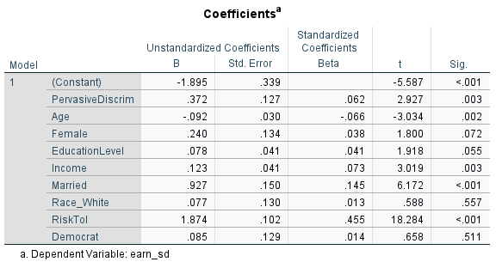
Table 3 Model (2): Results
Questions
6. How did the inclusion of the control variables affect the coefficient for Pervasive discrimination?
7. How would you interpret the coefficient of interest?

Slide 15
Table 3 Model (2): Answers
6. The coefficient for Pervasive discrimination fell from .470 to .372, because of the effect of age, education level, income, marital status, and risk tolerance. The coefficient of interest also remained significant at the 1% level, further indicating that participants from the pervasive discrimination group expected greater variability in income uncertainty than the rare discrimination group while controlling for other factors.
7. Since this is a multivariate regression, we must hold all other variables constant (certeris paribus) when interpreting the coefficient for Pervasive discrimination. Now the coefficient can be interpreted as follows: assignment to the pervasive discrimination group accounted for a 0.37%-point increase in the standard deviation of the participant’s expected earnings growth rate while holding all other factors equal.

Slide 16
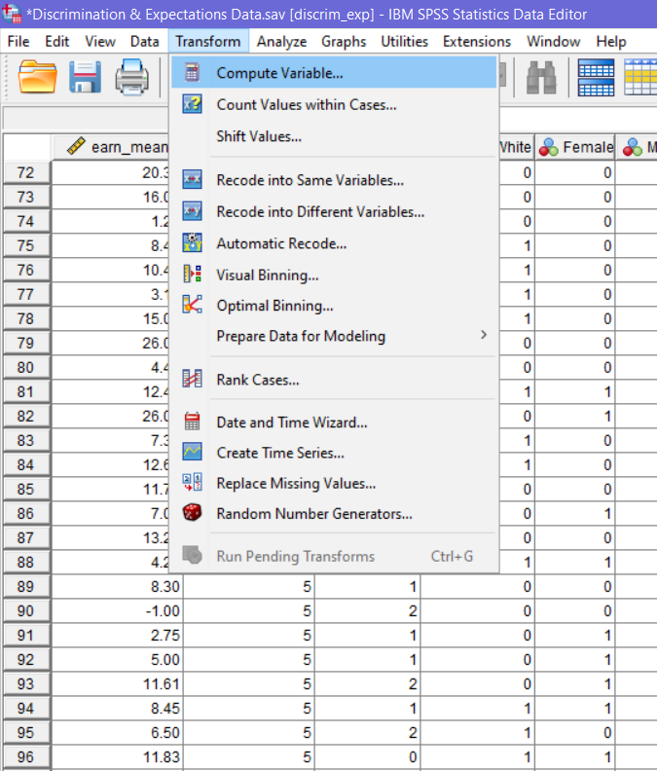
Improving model (2) with variable transformations: Square Risktol
7. Open the “Compute Variable” procedure
Creating a quadratic variable for RiskTol, which is an index composed of gambling and investing risk assessment questions, suggests that income uncertainty increases with risk tolerance up to a point, after which the effect starts to diminish.

Slide 17
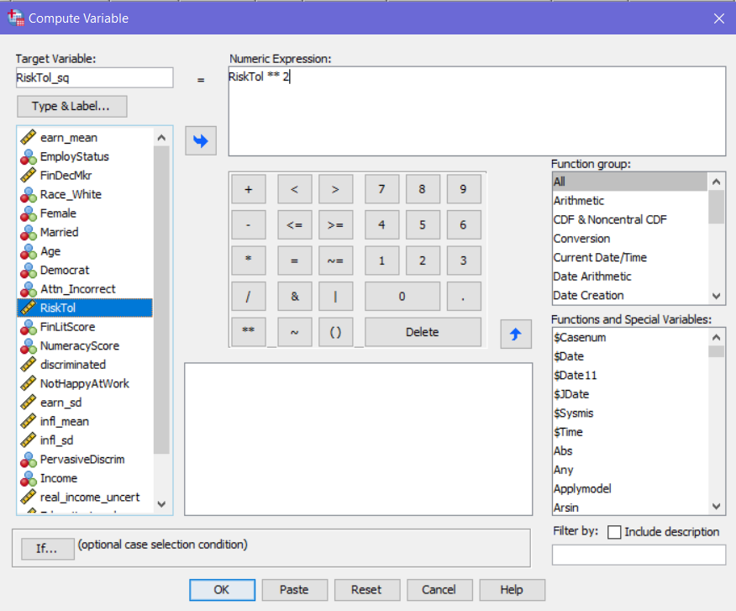
Improving model (2) with variable transformations: Square Risktol
8. Name the target variable “RiskTol_sq”
9. Select the variable from the list, click the ** and 2 from the number pad and
10. Click “OK” to create the new variable

Slide 18
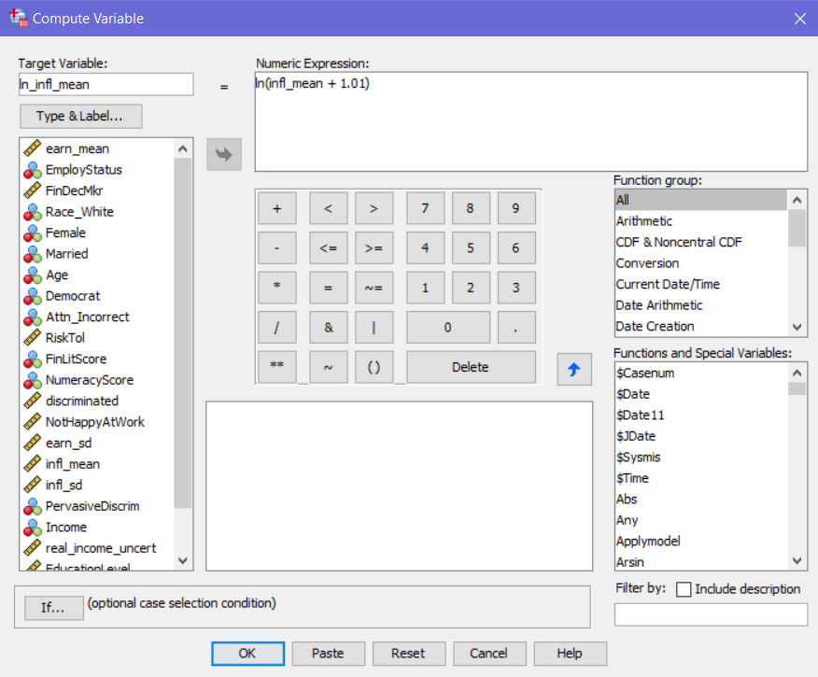
Improving model (2) with variable transformations: LN INFL_MEAN
11. Repeat the “Compute Variable” procedure and name the target variable “ln_infl_mean”
12. Enter ln(infl_mean + 1.01) into the expression window and click “OK”
Infl_mean is the participant’s average expected rate of inflation over the next 12 months
Here we use a trick for log transformations on variables that include values 0 or less by adding a small constant to avoid undefined computations while minimally distorting the true values

Slide 19
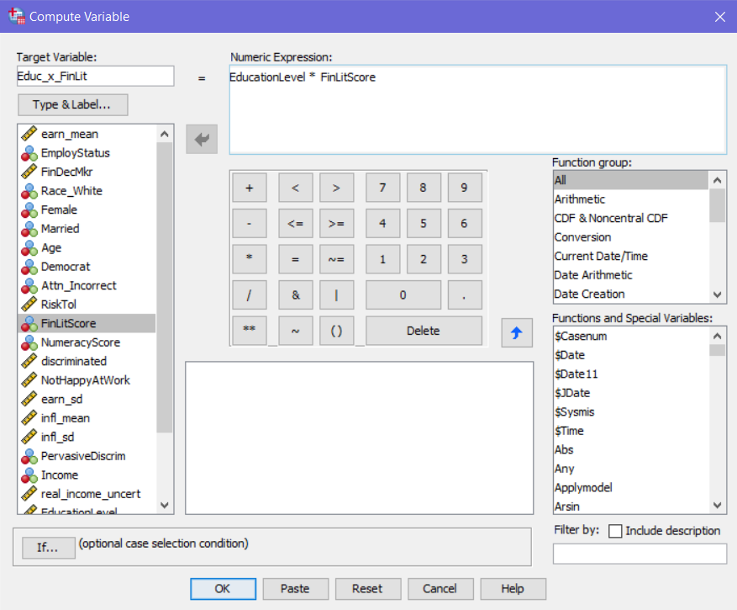
Improving model (2) with Interaction Terms: educationlevel * finlitscore
13. Repeat the “Compute Variable” procedure and name the target variable “Educ_x_FinLit”
14. Select EducationLevel from the list then click * and select FinLitScore and click “OK”
Interaction between FinLitScore, which is an index from zero (low literacy) to three (high literacy) based on three literacy questions and EducationLevel: (0) some high school, (1) high school graduate, (2) some college, (3) associate’s degree, (4) undergraduate degree, (5) postgraduate degree, (-1) prefer not to answer

Slide 20
Improving model (2): Reasoning
ln_infl_mean helps explain the diminishing impact of inflation expectations on income uncertainty, capturing non-linear sensitivity to inflation.
RiskTol_sq explains the diminishing returns effect of risk tolerance on income uncertainty, showing that its impact weakens at higher levels.
Educ_x_FinLit clarifies how financial literacy's effect on reducing income uncertainty is stronger for those with higher education, indicating a synergistic relationship between education and financial literacy.

Slide 21
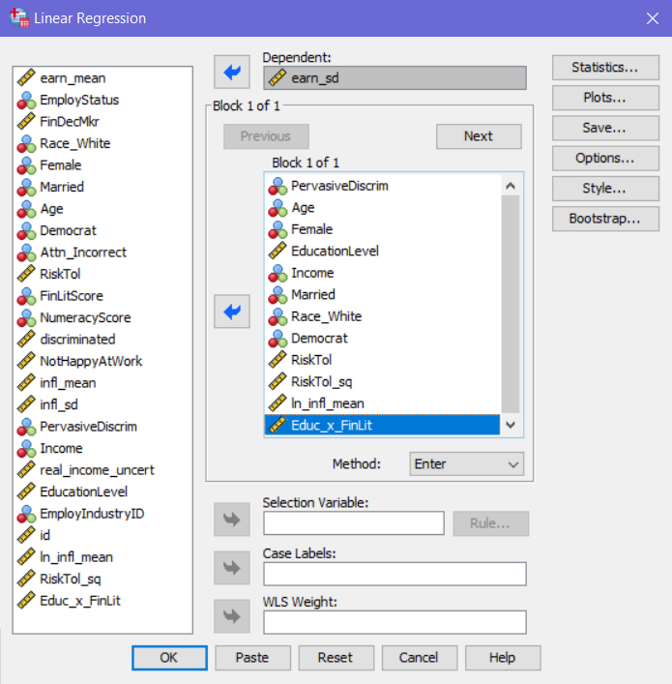
Improving model (2): Running the model with the new variables
15. Repeat the linear regression procedure and add the new variables to the model
16. It is good practice to keep the squared and non-squared variables next to each other in the model, so ensure that RiskTol and RiskTol_sq are
17. Click “OK” to run the model

Slide 22
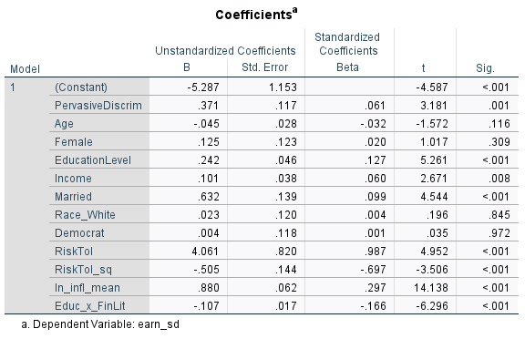
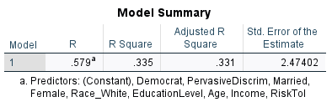
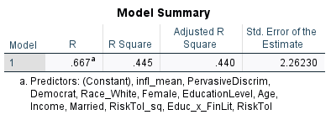
Improving model (2): Results
New Model (2)
Original Model (2)

Slide 23
Improving model (2): Results
Questions
8. How does the adjusted R² differ between the two models, and what does this tell us about the new model's explanatory power?
9. Does an increase in adjusted R² justify the inclusion of additional terms in the model? Why or why not?
10. What is the interpretation of ln_infl_mean?
11. What does the interaction term Educ_x_FinLit tell us about the combined impact of education level and financial literacy on income uncertainty?
12. What is the interpretation of RiskTol_sq if the score on the index is the average of 2.89?

Slide 24
Improving model (2): Answers
8. The adjusted R² increased from 0.331 in the simpler model to 0.440 in the model with transformations and interactions, suggesting that the more complex model explains 10.9% more variance in income uncertainty.
9. The increase in adjusted R² does justify the inclusion of these additional terms because they enhance the model's explanatory power in a way that is statistically meaningful. By capturing non-linear and interactive effects, the model offers a more accurate and interpretable representation of the factors influencing income uncertainty.
10. For every 1% increase in the average expected inflation rate, we would expect the standard deviation of the participant’s expected earnings growth rate to increase by 0.0088%-point (since a 1% increase translates to a 0.01 increase in the log scale).
11. Educ_x_FinLit indicates that financial literacy’s ability to reduce income uncertainty depends on education level. Financial literacy is more effective in reducing uncertainty for individuals with higher education levels, suggesting that education amplifies the benefits of financial knowledge.
12. Slope = coefficient of RiskTol + 2 * (coefficient of RiskTol_sq) * (2.89)
Slope = 4.061 + (2 * -0.505 * 2.89) = 1.14
Participants with an average risk tolerance (2.89) see a 1.14% points increase in standard deviation of expected earnings growth rate.

